Slide 1
Searching and Sorting
Module 12

Slide 2
Topics
Big O Notation
Search
Linear search
Binary search
Sort
Insertion sort
Merge sort
Selection sort
Quicksort

Slide 3
Big O notation
Denoted as O(n), O(n log n), etc.
Describes the time complexity of algorithms.
It helps us understand how the performance of an algorithm scales with the size of its input.

Slide 4
Notation | Meaning
O(1) - Constant Time Complexity: | This indicates that the time or space required by the algorithm remains constant regardless of the size of the input. It means the algorithm's performance does not depend on the input size.
O(log n) - Logarithmic Time Complexity: | This indicates that the time or space required grows logarithmically with the size of the input. Algorithms with logarithmic time complexity typically divide the input in half with each step, such as binary search.
O(n log n) - Linearithmic Time Complexity: | This indicates that the time or space required grows in proportion to n times the logarithm of n. This represents a balance between efficiency and scalability. Algorithms with linearithmic time complexity often involve divide-and-conquer approaches, such as merge sort and quicksort.
O(n) - Linear Time Complexity: | This indicates that the time or space required grows linearly with the size of the input. In other words, the performance of the algorithm increases linearly as the input size increases. If the size of the input increases by a certain factor, such as doubling, the time or space required by the algorithm also increases by the same factor.
O(n²) - Quadratic Time Complexity: | This indicates that the time or space required grows quadratically with the size of the input. Algorithms with quadratic time complexity often involve nested loops, such as bubble sort and insertion sort. Algorithms with quadratic time complexity are generally less efficient than linear or logarithmic algorithms for large inputs and may become impractical for very large datasets.

Slide 5
Other Big O Notations
O(n^{k}) - Polynomial Time Complexity:
This indicates that the time or space required grows as a polynomial function of the input size, where k is a constant. Higher values of k indicate higher polynomial degrees, resulting in slower growth rates.
O(2^{n}) - Exponential Time Complexity:
This indicates that the time or space required doubles with each additional element in the input. Algorithms with exponential time complexity become quickly impractical for large inputs.
O(n!) - Factorial Time Complexity:
This indicates that the time or space required grows factorially with the size of the input. Algorithms with factorial time complexity are highly inefficient and often impractical for any but the smallest inputs.

Slide 6
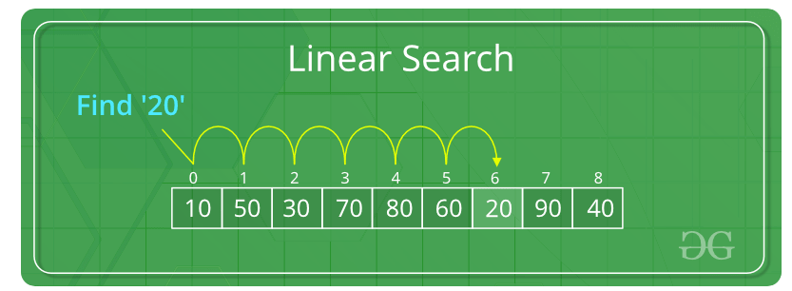
Linear Search
Time Complexity: O(n)

Slide 7
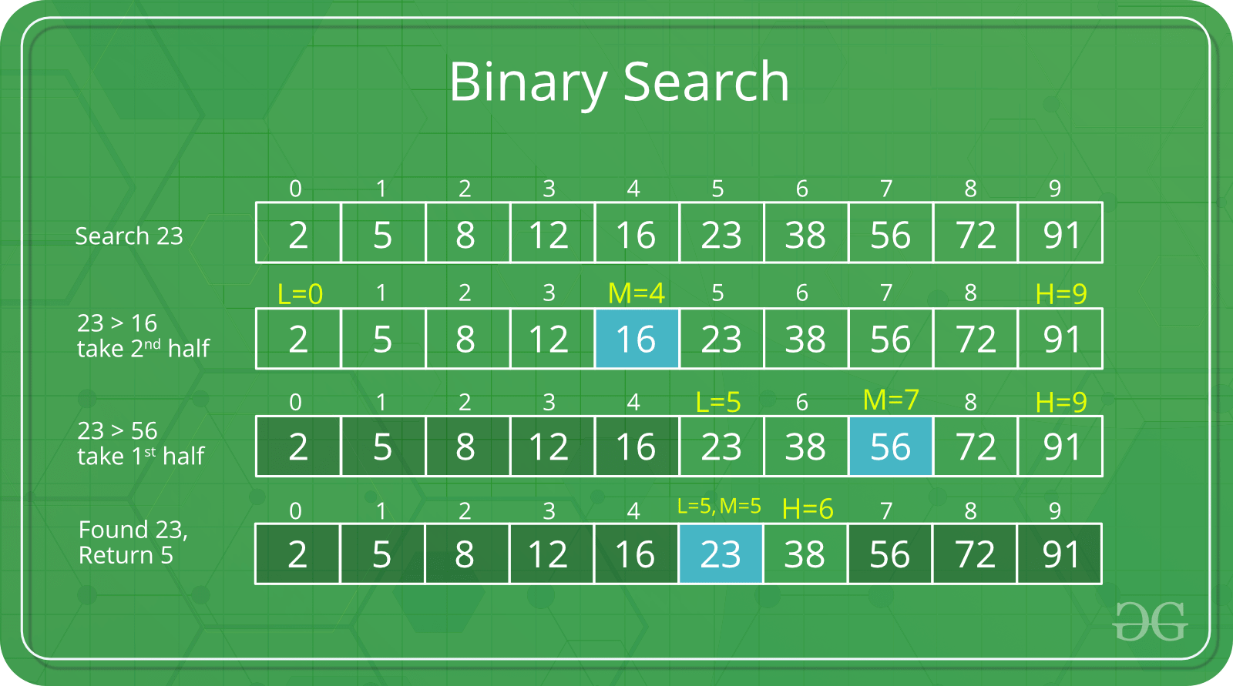
Binary Search
Time Complexity: O(log n)
requires a sorted array
starts with the element in the middle of the array
If that element is the desired value, the search is over.
Otherwise, the value in the middle element is either greater or less than the desired value
If it is greater than the desired value, search in the first half of the array.
Otherwise, search the last half of the array.
Repeat as needed while adjusting start and end points of the search.

Slide 8
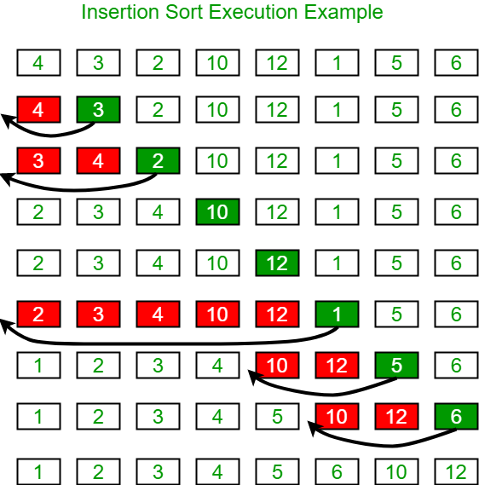
Insertion Sort
Time Complexity: O(n²)
due to nested loops
Easy to understand
Easy to code
No recursion
Efficient for sorting small lists or partially sorted arrays
Doesn't require extra memory beyond the input array itself
Insertion sort is suitable for online sorting scenarios where elements are continuously added to the input list and need to be sorted incrementally.

Slide 9
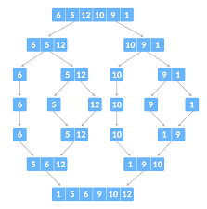
Merge Sort
Time Complexity: O(n log n)
more efficient than the insertion sort for large arrays.
Divides the array recursively into halves until each subarray contains only one element, and then merges these subarrays back together in sorted order.
Consistent performance regardless of the initial order of elements in the array.
Suitable for sorting large datasets.
The divide-and-conquer nature of merge sort allows for efficient parallelization, which can lead to significant performance improvements on systems with multiple processors or cores.
Merge sort is well-suited for external sorting scenarios where the entire dataset cannot fit into memory at once. It can efficiently sort large datasets stored on external storage devices (such as hard drives or SSDs) by reading and writing data in chunks, minimizing disk I/O operations.
Needs additional memory for temporary arrays

Slide 10
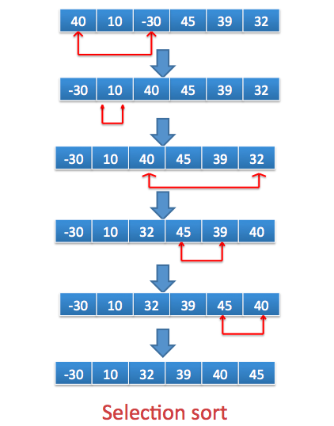
Selection Sort
Time Complexity: O(n²)
Easy to understand
Easy to code
doesn't require additional memory beyond the input array itself.
Best for small datasets where complex algorithms like quick sort lose efficiency.
Minimal swapping compared to other algorithms.
Best used when simplicity and memory usage are prioritized over performance.
Since it compares each element with every other element in the unsorted subarray, its time complexity grows quadratically with the size of the array.

Slide 11
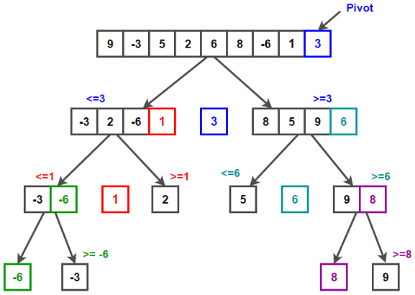
Quick Sort
Time Complexity: O(n log n) on average, O(n²) in worst case
One of the fastest sorting algorithms available. It performs exceptionally well on average for most input distributions, especially for large datasets.
Doesn't require additional memory beyond the input array itself.
Accesses memory locations that are close to each other, which can result in better performance.
Amenable to parallelization, allowing for efficient use of multi-core processors and parallel computing environments. Divides the workload!
Worst-case time complexity is O(n²) when poorly chosen pivots lead to unbalanced partitions, so careful implementation and pivot selection are crucial for optimal performance.

Slide 12
End of Lecture

